Slide 1
NCAA Tournament Machine Learning

Slide 2
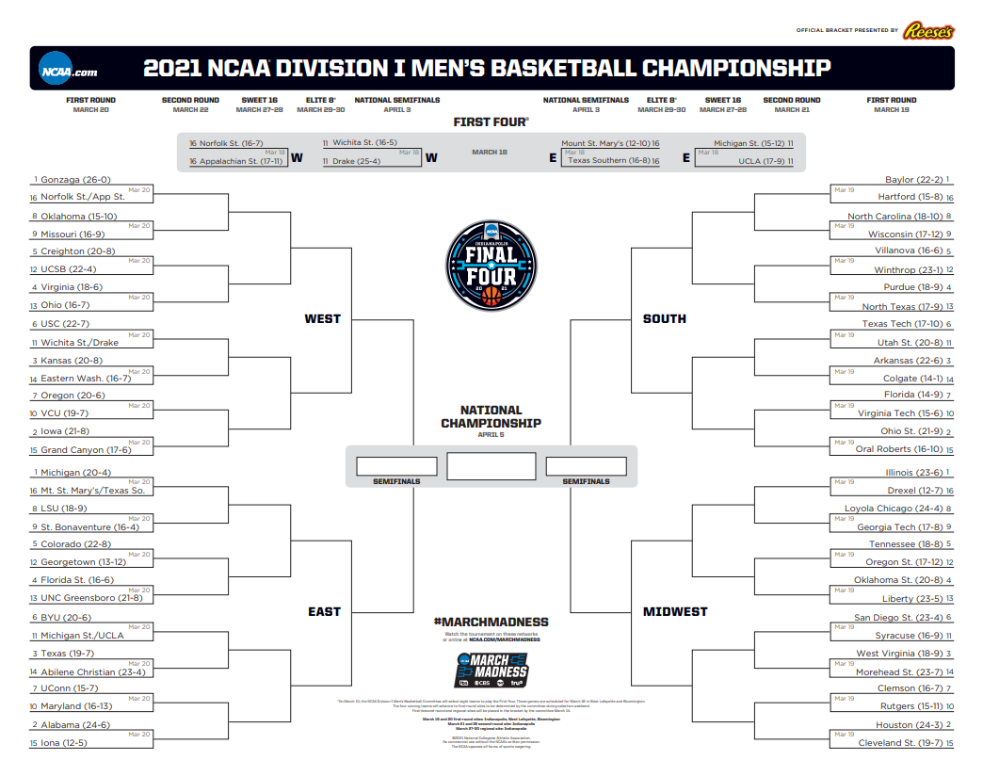
NCAA Tournament Overview

Slide 3
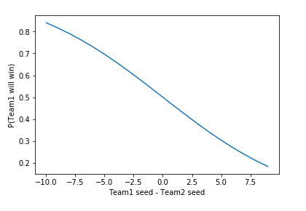
2019 – My Model

Slide 4
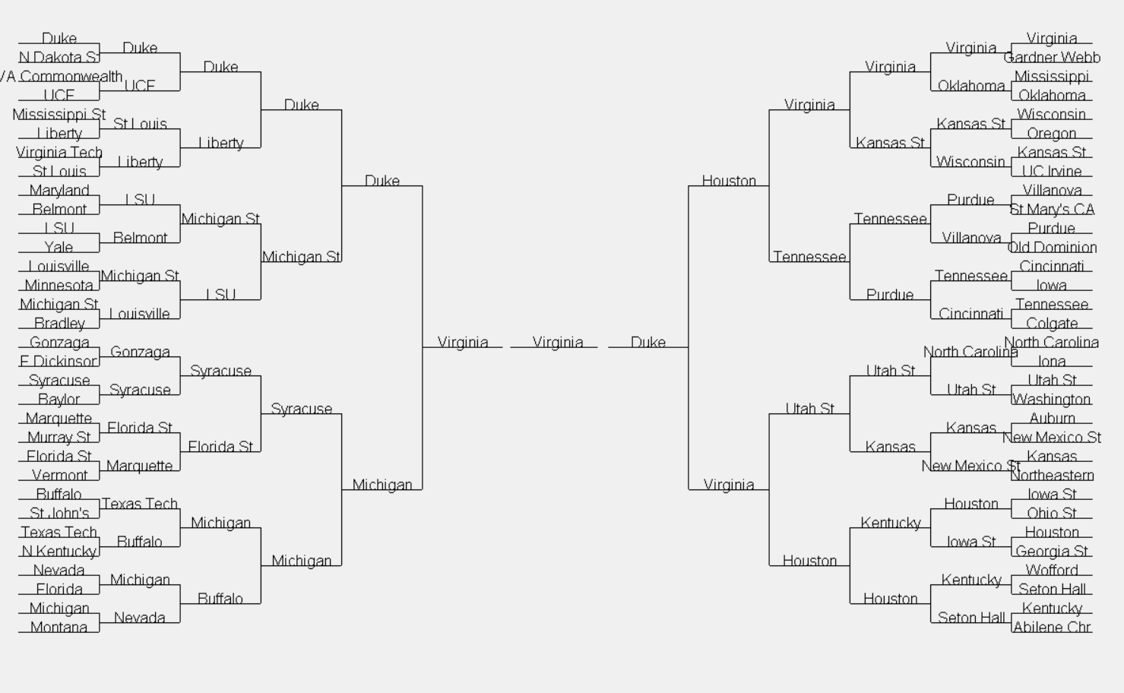
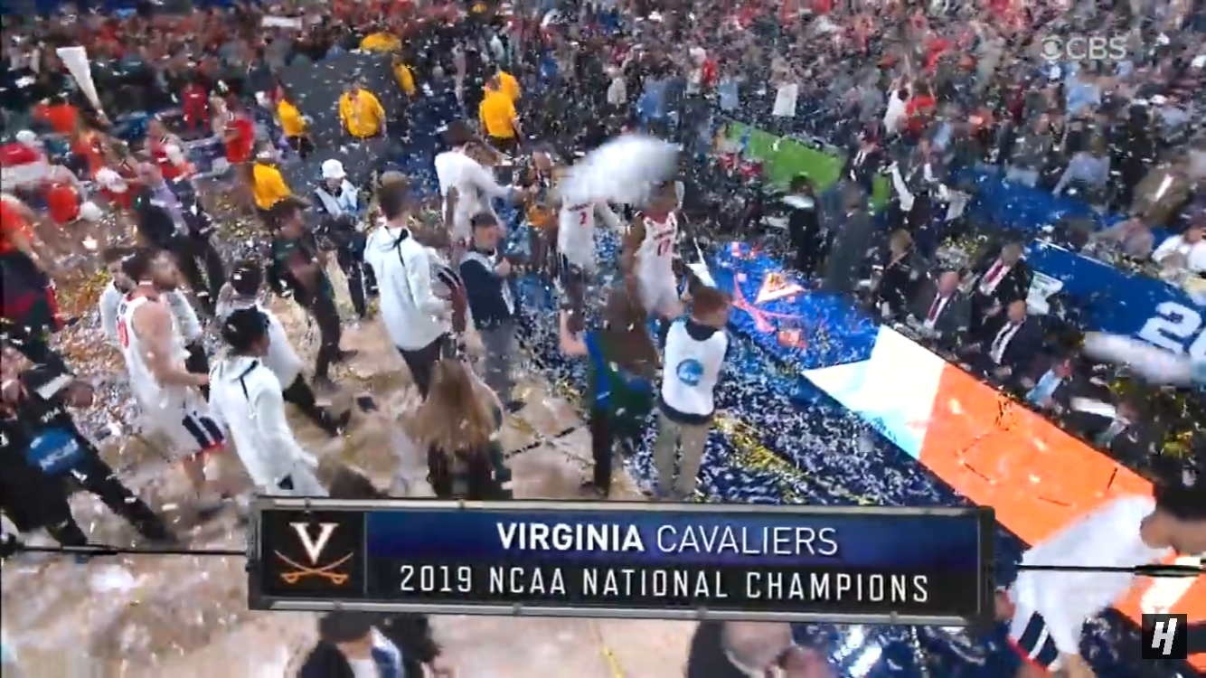
2019 - Results

Slide 5
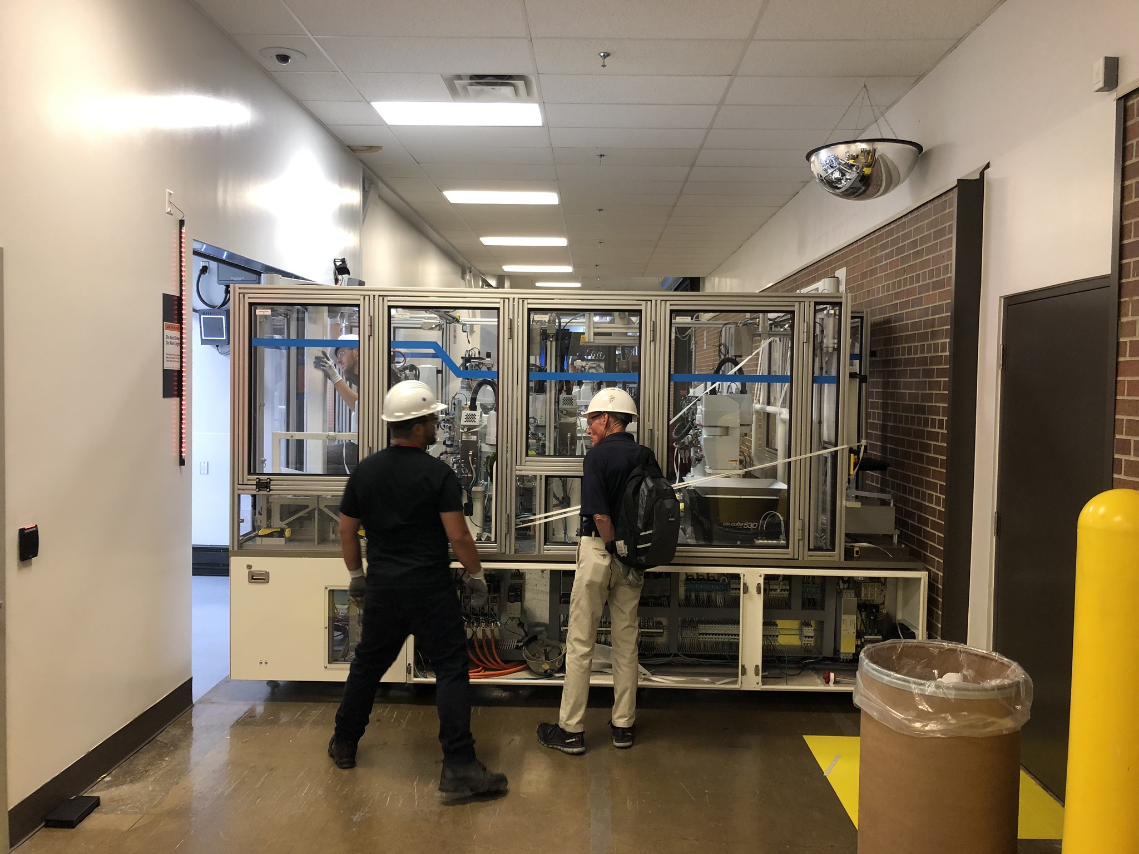
IDM Asset Delivery

Slide 6
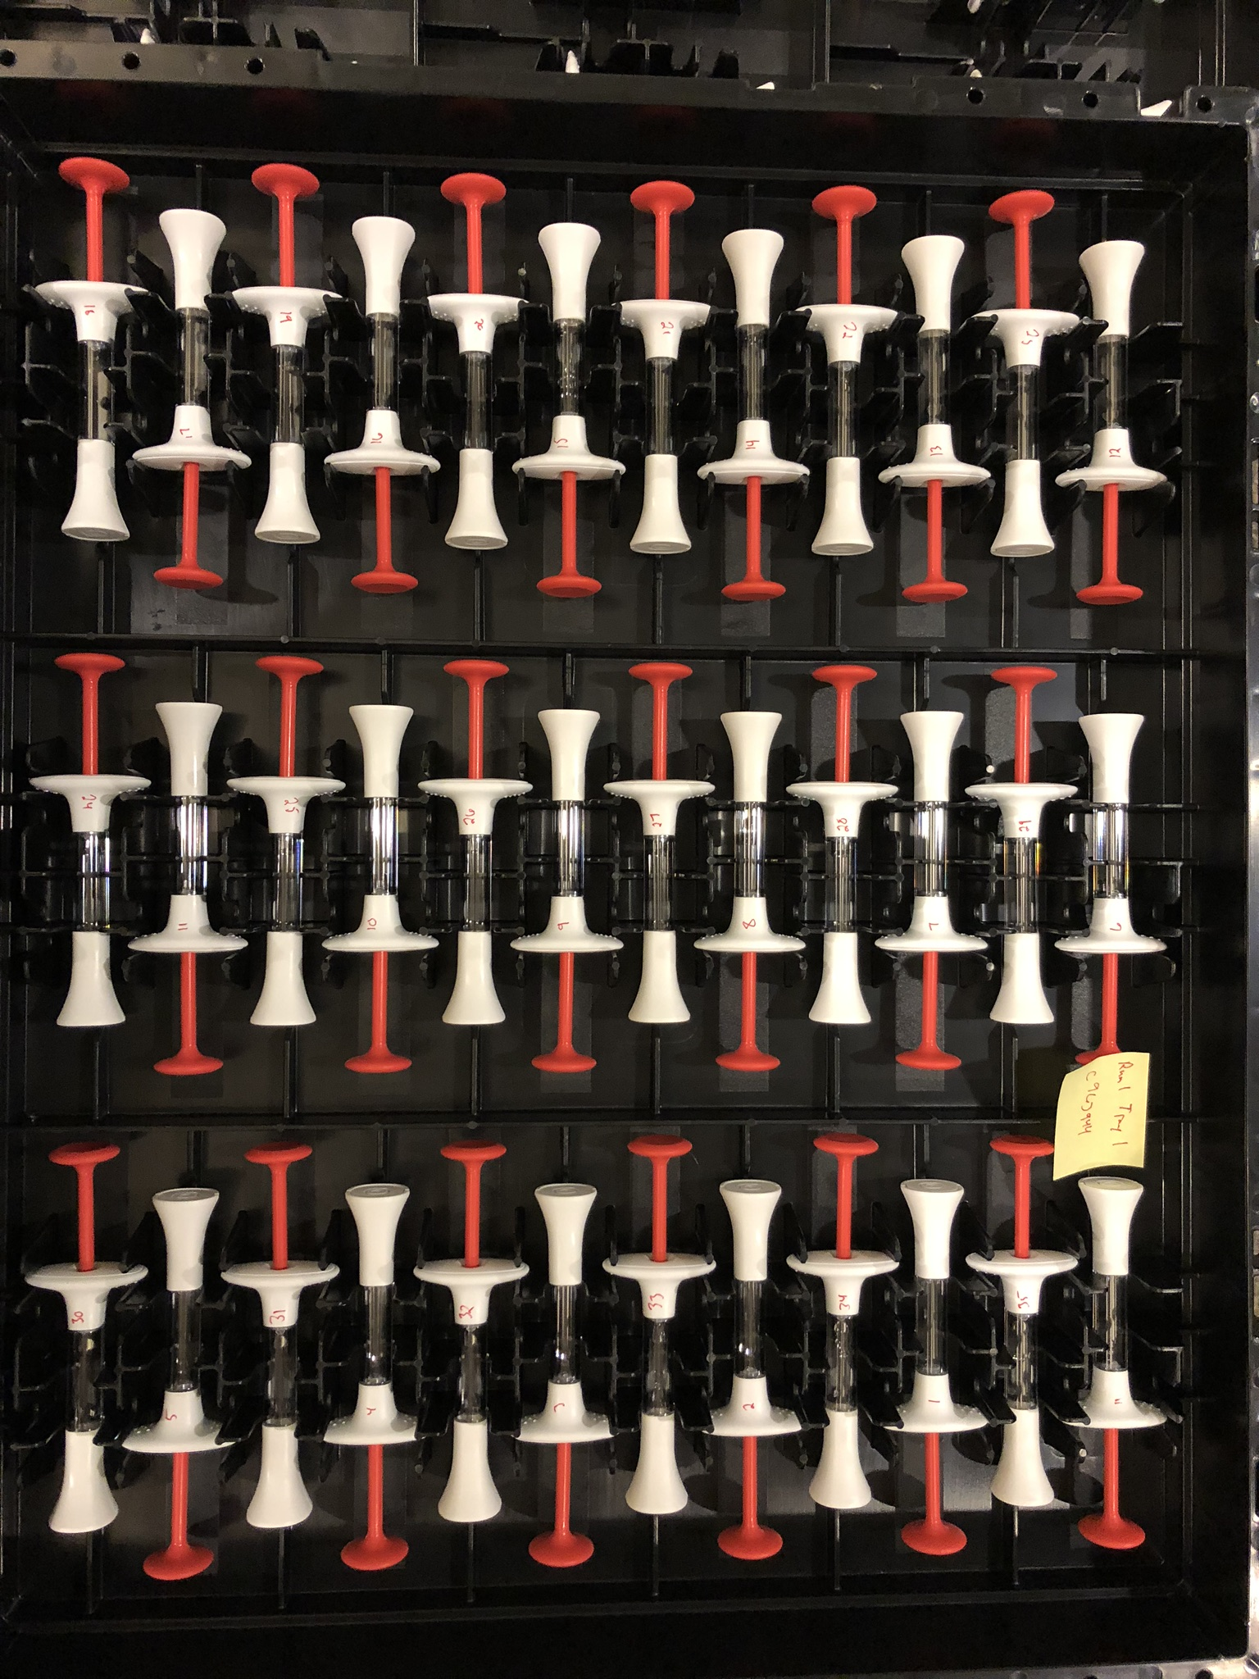
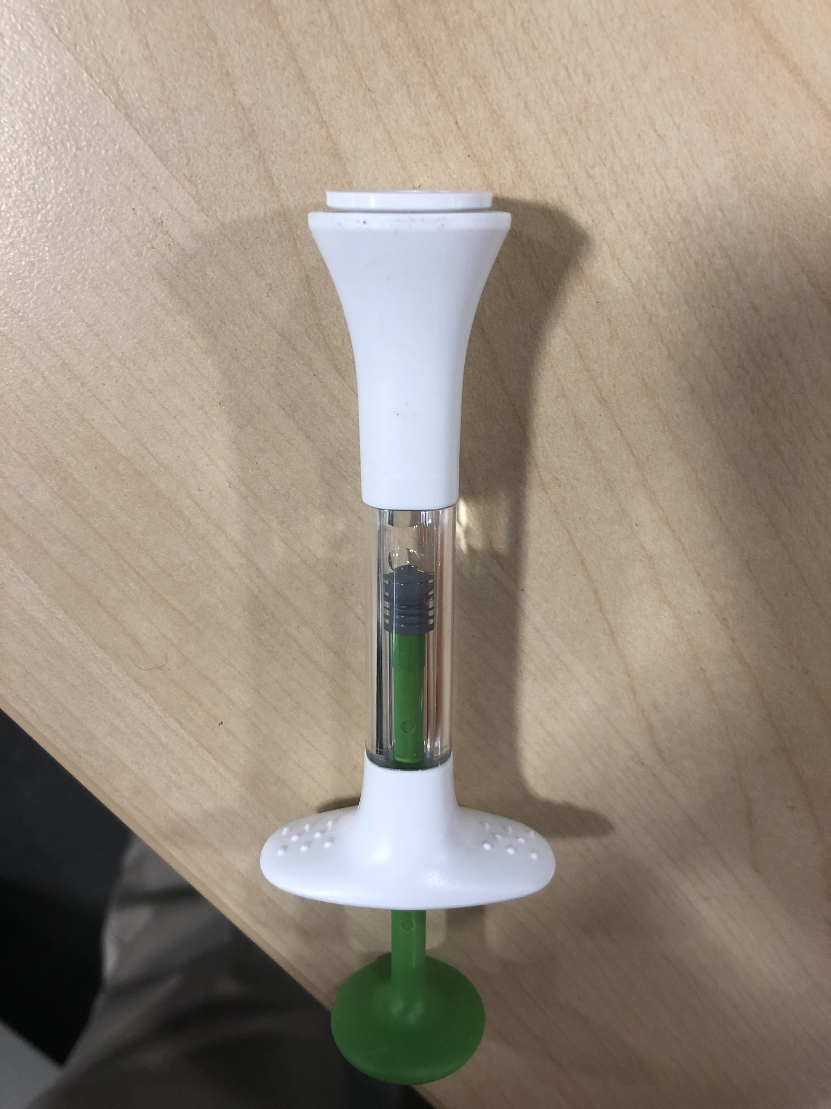
IDM Asset Delivery

Slide 7

What is Machine Learning?

Slide 8
Purpose
The purpose of this lunch and learn is for attendees to gain a deeper understanding of what is involved in machine learning
Not how to code
Not which machine learning algorithms are “best”
Not to win NCAA tournament pools

Slide 9


Use Jupyter Notebooks with Python Kernel

Slide 10
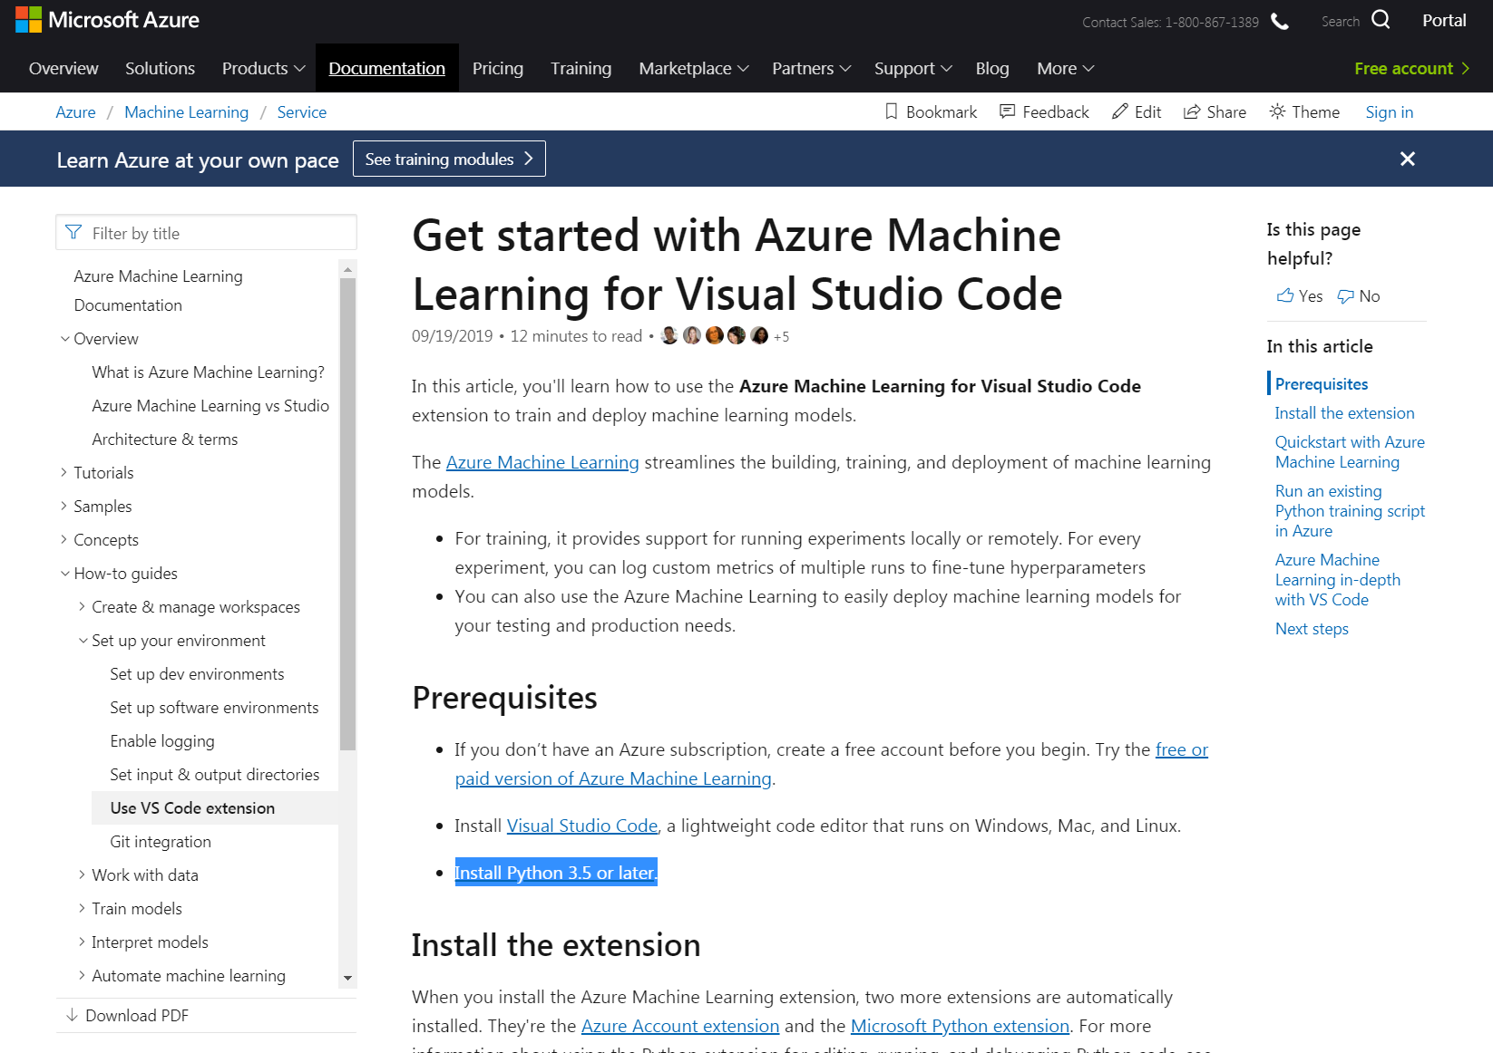
Microsoft’s Machine Learning Tool

Slide 11
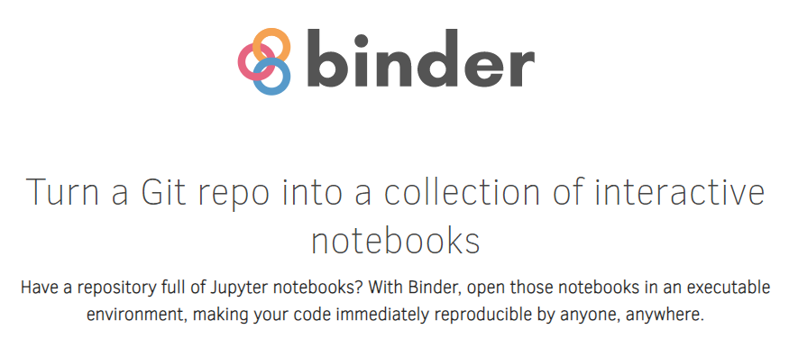
Binder allows running Jupyter Notebooks in the cloud
https://github.com/C176616/March-Madness-2021.git

Slide 12
Quick Disclaimer
This is a difficult problem (especially first problem)
Do not bet money with this bracket. You will lose

Slide 13

Types of Machine Learning
Notes:
We are going to be working in the supervised learning space. This is made up of classification and regression. Classificatoin is if you want to know if something belongs to a category. Say you are coming up with an algorithm to determine the picture is a dog or a cat. Or is it a hot dog?

Slide 14
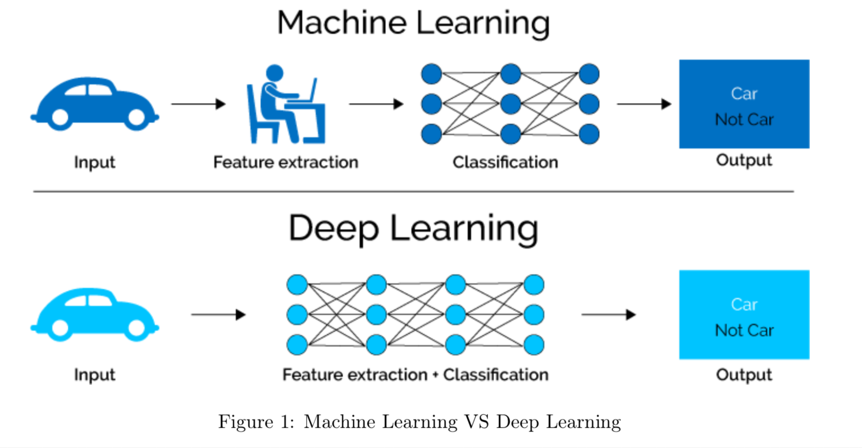
What is Classification?

Slide 15
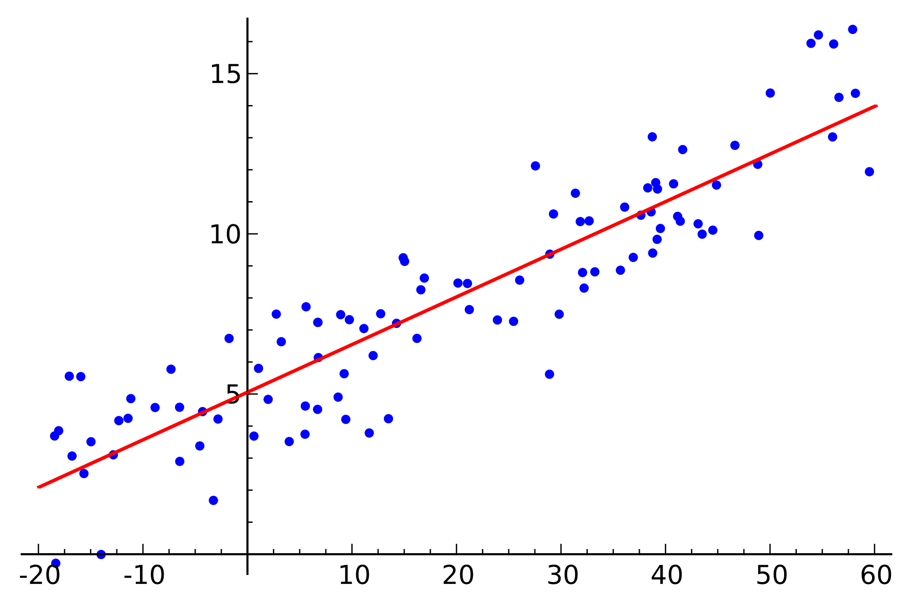
What is Regression?

Slide 16
Back to notebook

Slide 17
Cut to notebook – Part 2
Link here:
https://mybinder.org/v2/gh/thekevster08/MarchMadness/master

Slide 18

We will be using scikit learn

Slide 19


Major Machine Learning Libraries

Slide 20
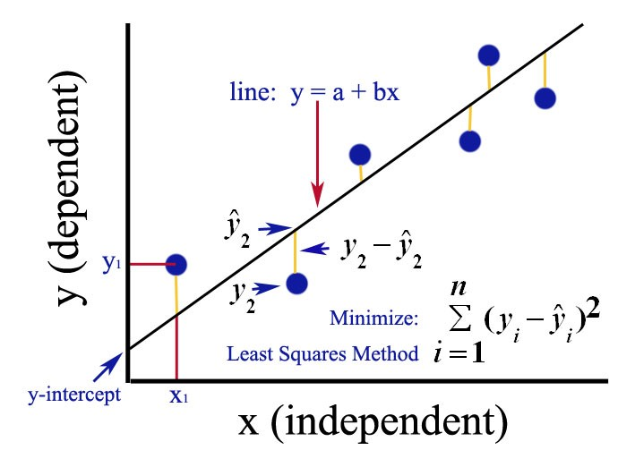
Ordinary Least Squares

Slide 21
Back to notebook

Slide 22
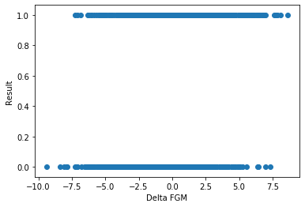
Recall - Categorical Data

Slide 23

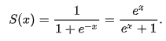
Sigmoid Function

Slide 24
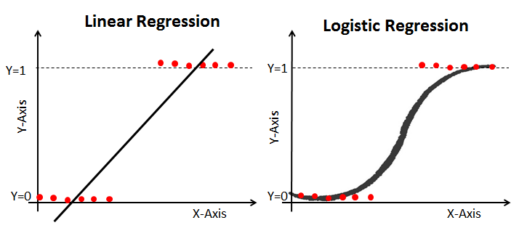
Logistic Regression

Slide 25
Back to notebook

Slide 26
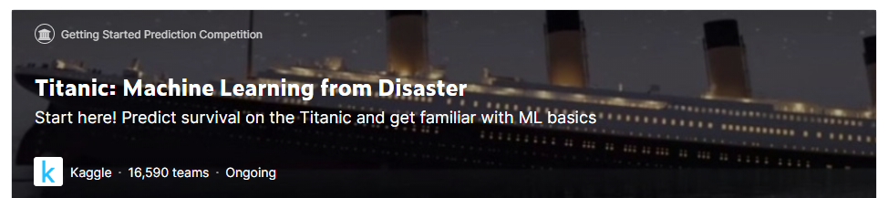
Kaggle – Titanic Challenge

Slide 27
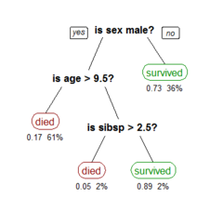
Decision Tree Classifier

Slide 28
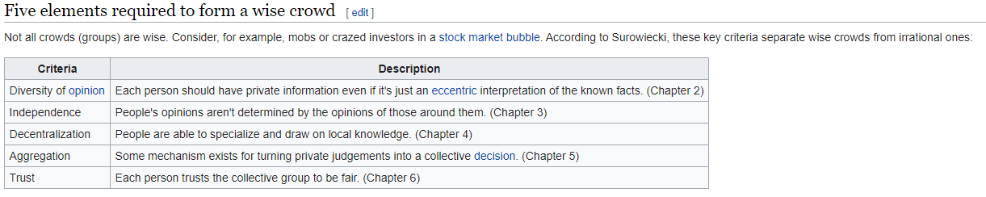
Wisdom of Crowds
Wisdom of crowds is the idea that large groups of people collectively smarter than individual experts when it comes to problem-solving, decision making, innovating and predicting.

Slide 29
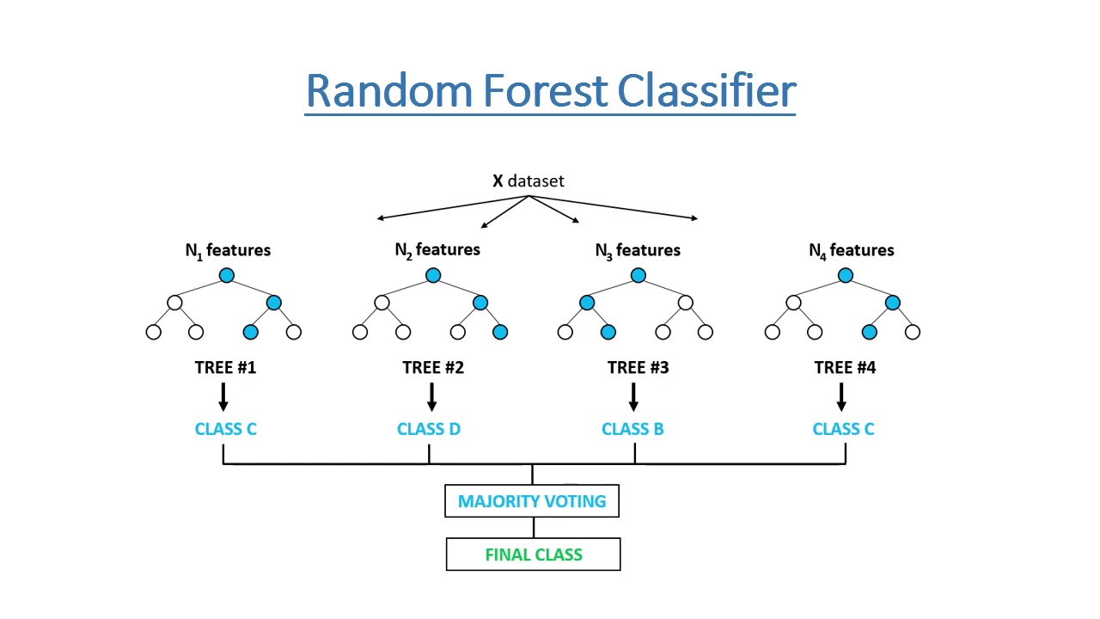
Random Forest Classifier

Slide 30
Back to notebook

Slide 31
What is deep learning?

Slide 32
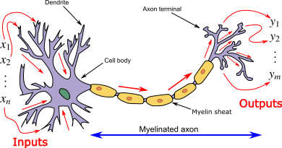
A neural network mimics an actual neuron

Slide 33

Neural Network Architecture

Slide 34
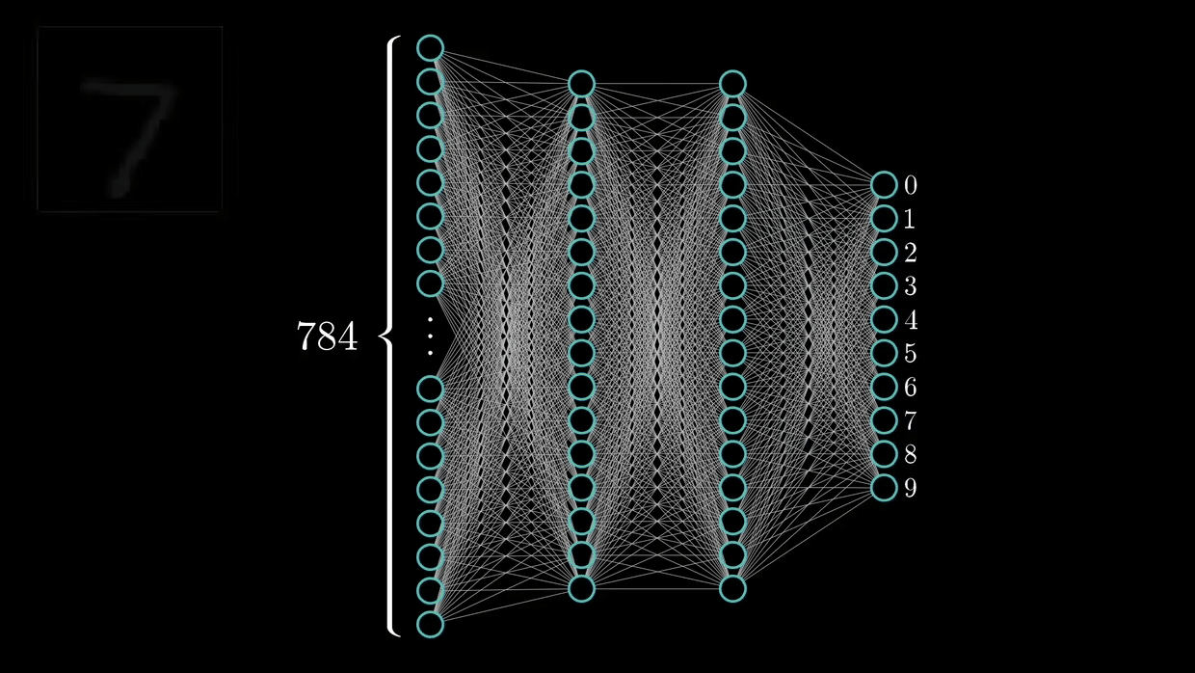
Training a Neural Network

Slide 35
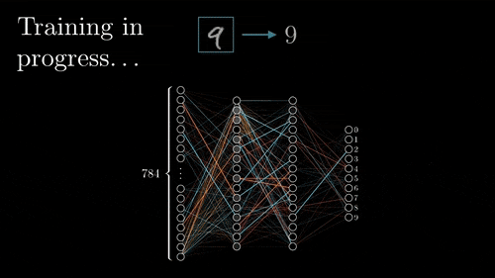
Back Propogation

Slide 36
To notebook

Slide 37
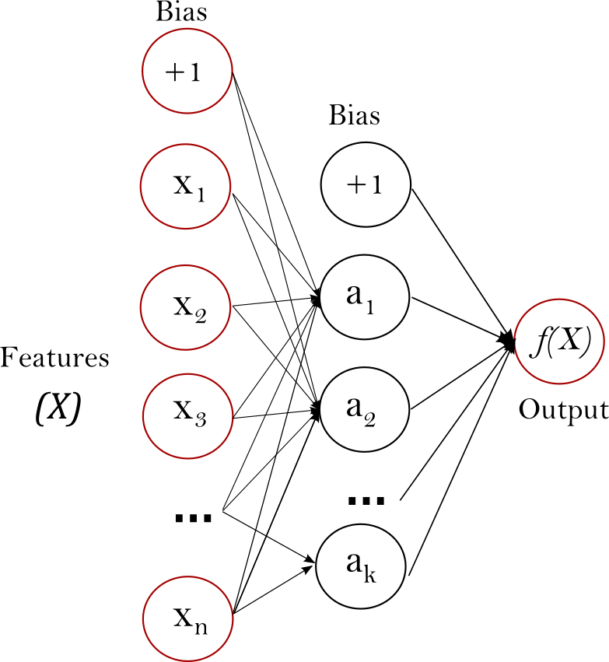
Scale Your Features!

Slide 38
To notebook

Slide 39
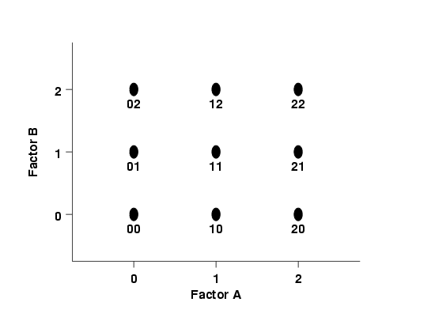
DOE Fundamentals

Slide 40
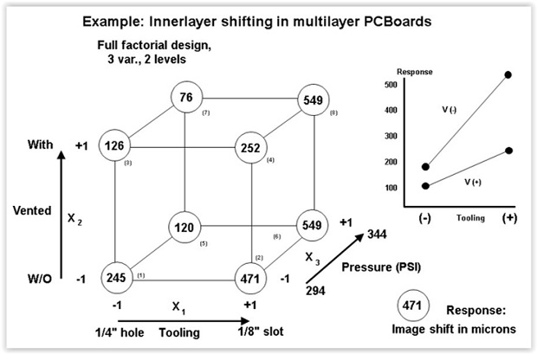
DOE Fundamentals

Slide 41
To Notebook

Slide 42
Source Material
https://github.com/cshaley/bracketeer
https://www.kaggle.com/juliaelliott/basic-starter-kernel-ncaa-men-s-dataset

Slide 43
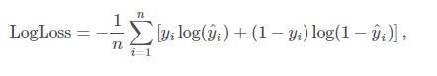
Contest Part 1 – Log Loss of Predictions
ID | Pred
2019_1101_1113 | 0.6
2019_1101_1120 | 0.2
2019_1101_1124 | 0.5
2019_1101_1125 | 0.5
2019_1101_1133 | 0.9
2019_1101_1138 | 0
2019_1101_1153 | 0.1
2019_1101_1159 | 0.7
2019_1101_1181 | 0
2019_1101_1192 | 0.8
2019_1101_1196 | 0.5
2019_1101_1199 | 0.4
2019_1101_1205 | 0.8
2019_1101_1209 | 0.6
2019_1101_1211 | 0
2019_1101_1222 | 0.1
2019_1101_1233 | 0.6
2019_1101_1234 | 0.4
2019_1101_1235 | 0.1
2019_1101_1242 | 0.2
2019_1101_1243 | 0.1
2019_1101_1246 | 0
2019_1101_1251 | 0.5
2019_1101_1257 | 0
n is the number of games played
y^i is the predicted probability of team 1 beating team 2
yi is 1 if team 1 wins, 0 if team 2 wins
log() is the natural (base e) logarithm
*2279 combinations

Slide 44
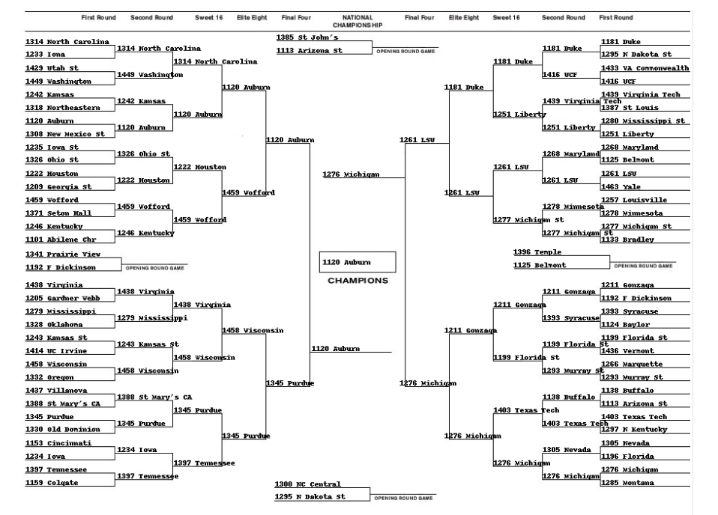
Contest Part 2 – Bracket

Slide 45
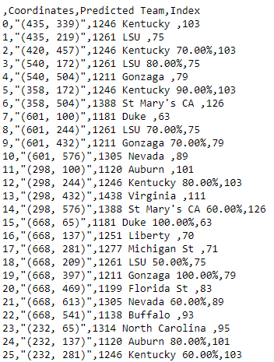
Contest Part 2 – Bracket

Slide 46
Your Submissions:
submission_predictions_part1_FIRSTNAME_LASTNAME
submission_bracket_part2_FIRSTNAME_LASTNAME
Email your submissions to me:
collins_kevin_a@lilly.com
I will email standings periodically.

Slide 47
Conclusion!
Thanks for Attending
Will have again next year, so feedback is welcome!
Visit Kaggle.come to learn more

Slide 48
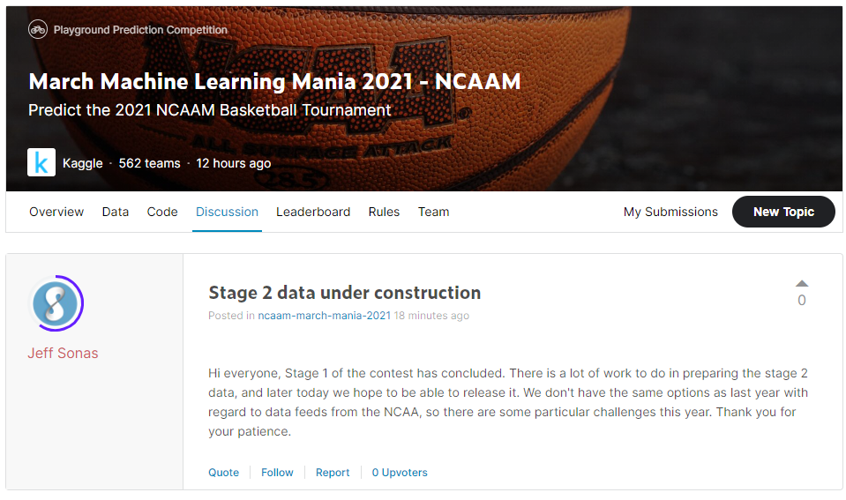
Stage 2 Data Unavailable

Slide 49
Teaser presentation

Slide 50
Explore Several Types of Models
Neural Network
Random Forest Classifier
Linear Regression
Logistic Regression
Decision Tree Classifier

Slide 51
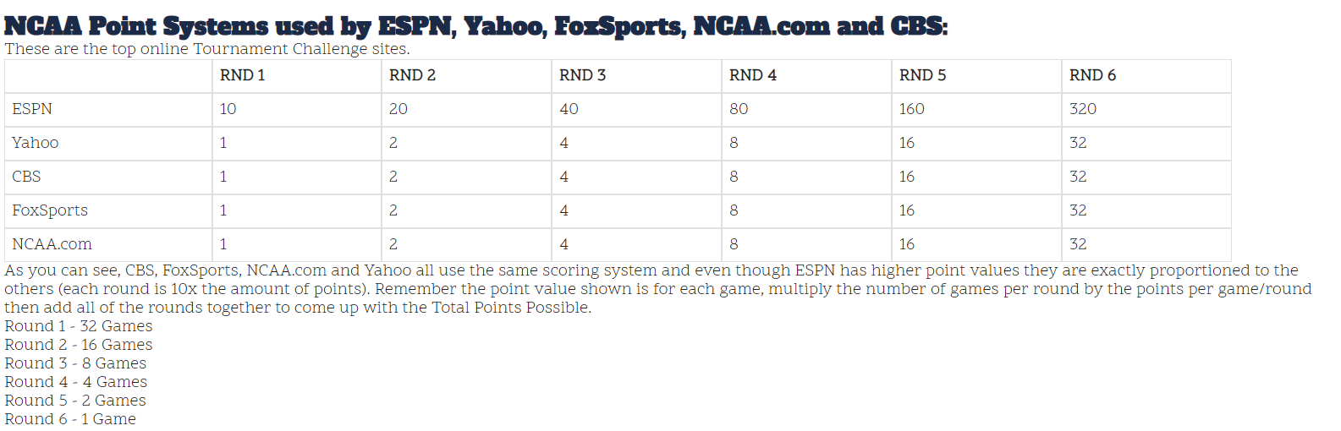
Contest Part 2 – Bracket

Slide 52
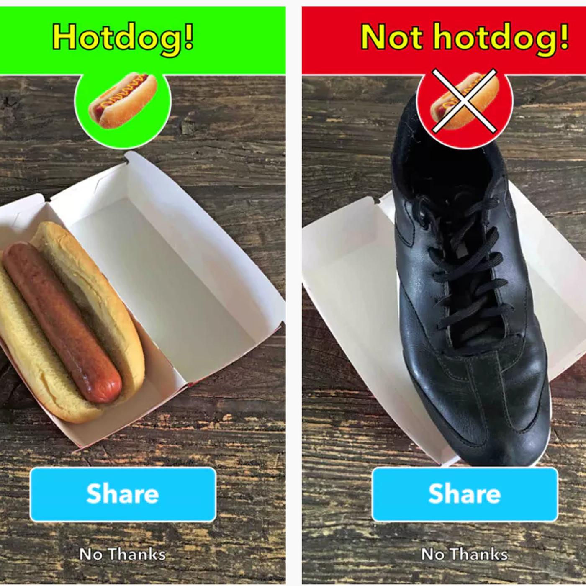

Example of Classification

Slide 53

isthisacat.com

Slide 54

Questions?

Slide 55
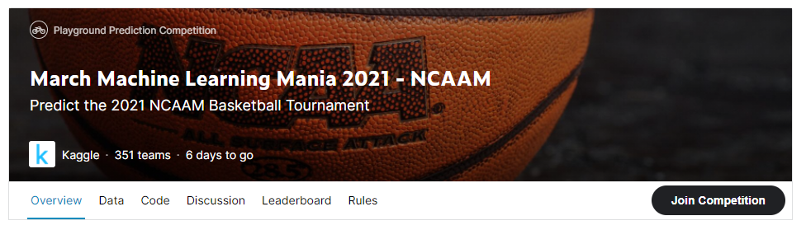
Official Competition

Slide 56
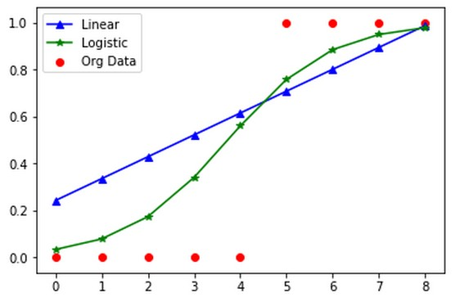

Slide 57
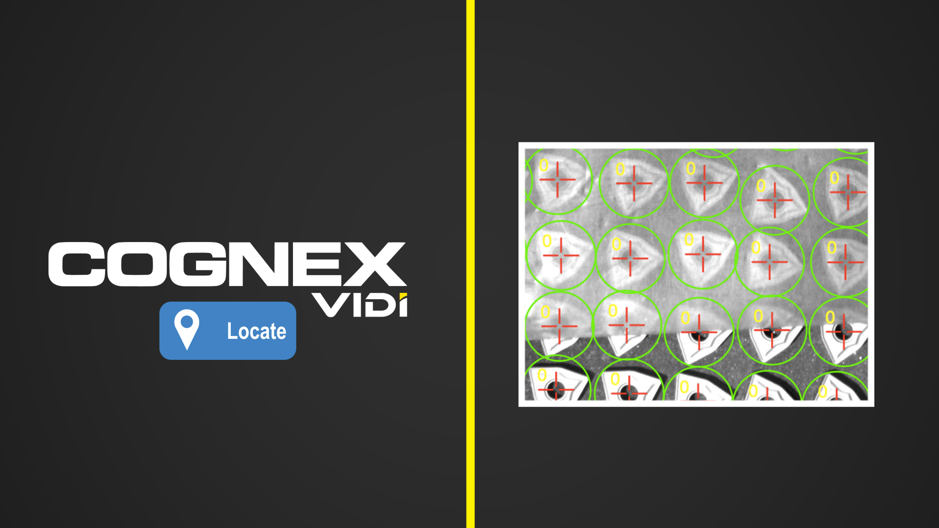
Cognex Vidi
Cognex Uses ViDi, Proprietary Deep Learning software

Slide 58
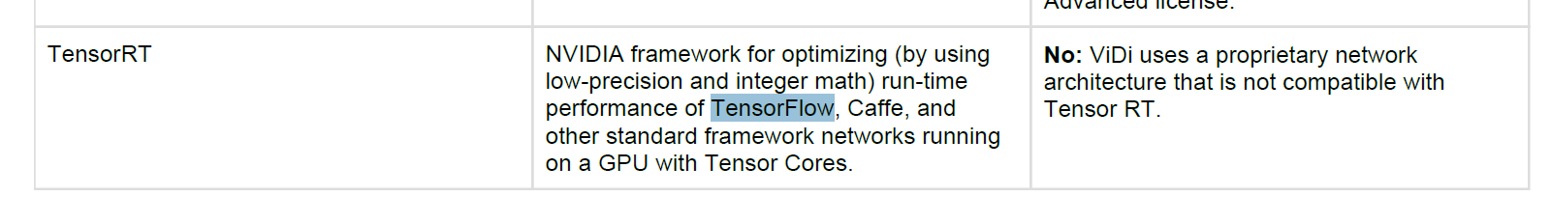
Cognex Vidi
ViDi’s “proprietary” algorithm is based on TensorFlow

